Slide 1


Progress Meeting – Feb. 5, 2023
Past week
Coming week
Simulation experiments
Assembly
Further software dev.
Order required sensors
Simulation experiments
Assembly

Slide 2
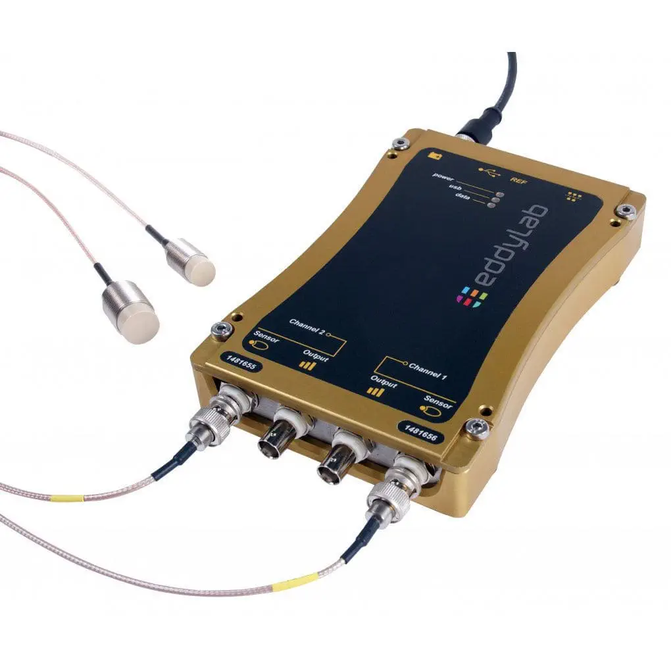
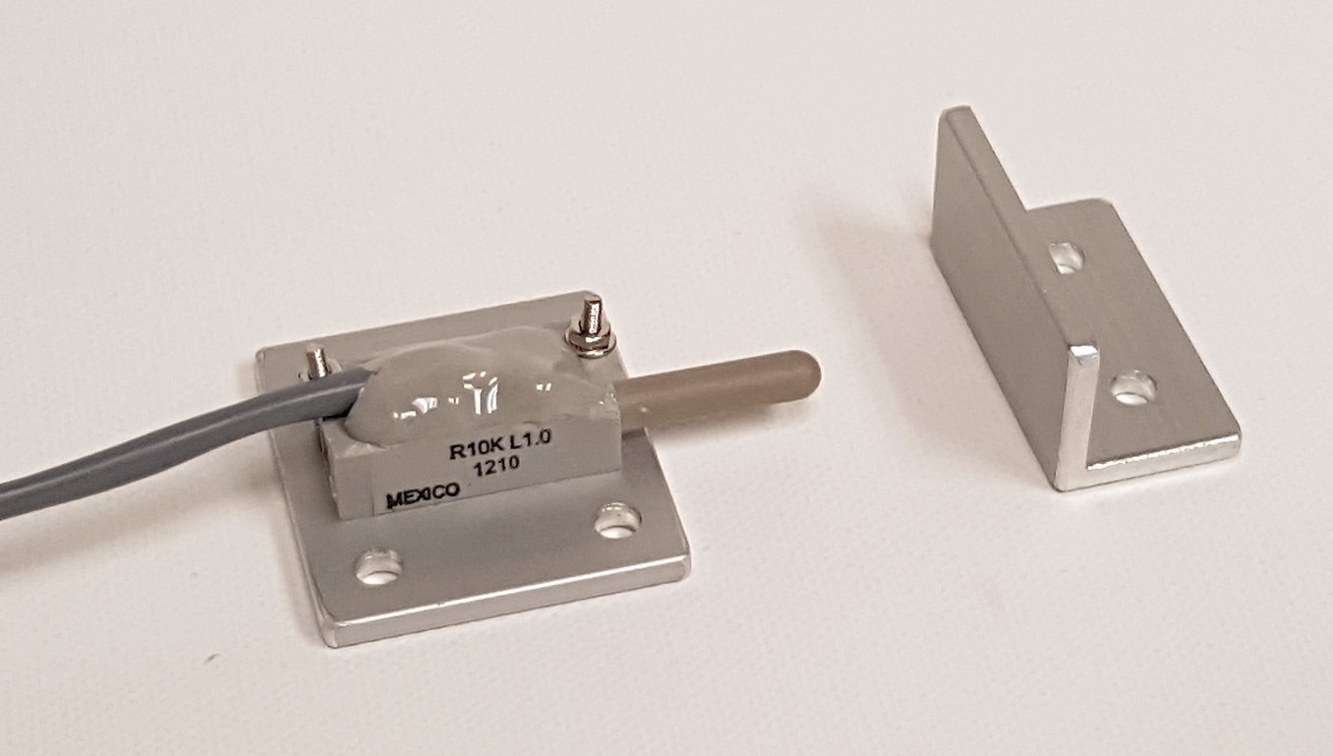
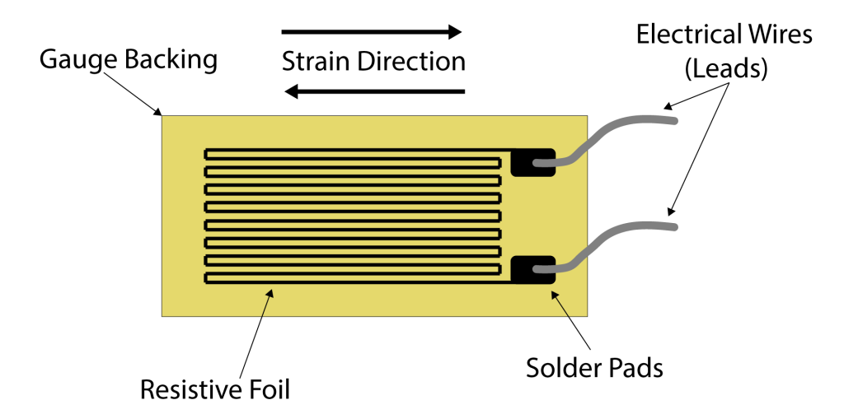
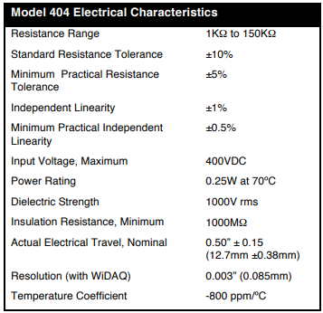
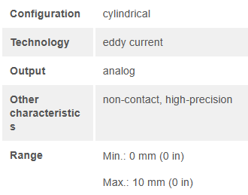
Measuring Linear Displacement
Eddylab – Cylindrical distance sensor
SMT Linear Displacement Sensor - $295
Strain Gauge
Limitations
Surface applied must be smooth or results can be misinterpreted
Cannot measure multi-direction loads
Performance affected by humidity, temperature and other external factors

Slide 3
What has everyone been working on?
Meia Copeland
Talal Jaber
Flexure redesign and simulation
Assembly
Shawaiz Khan
Ranishka Fernando
Code optimization
Email with attachments using Python
3D modelling – Flexure re-design
Research on displacement sensors and their limitations
Marwan Zeyada
UI Code Cleanup and Commenting
Preparing the UI for additional features

